Slide 1


The Ham Lane proposed hedge project sponsored by Tesco
This was the presentation made to the Governors of Priory School by Youth Board members
Rosa Hamilton, Molly McConnell and Heloise Pickup on 18th December 2024

Slide 2
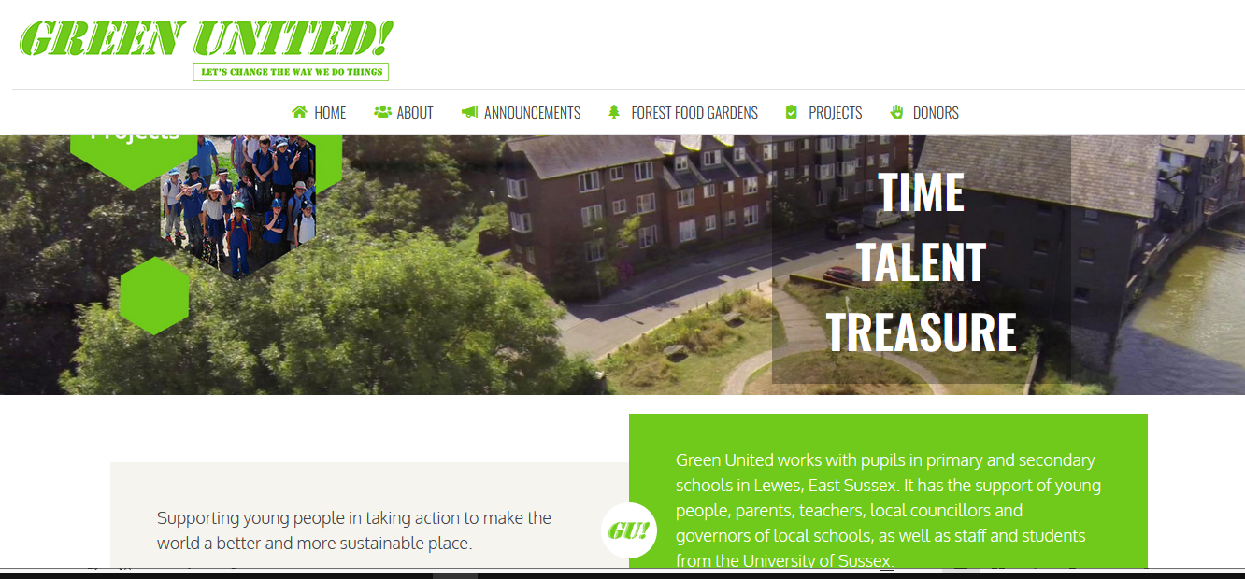

Slide 3


Slide 4
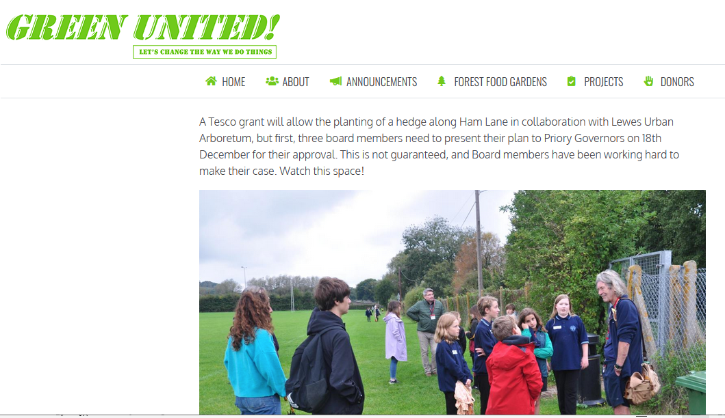

Slide 5
Background
We applied for a Tesco grant and were awarded £1,000
Our original idea for trees along the river Ouse was turned down by the Environment Agency.
Lewes Urban Arboretum members, who want to make Lewes a tree-filled town, suggested a hedge along Ham Lane.

Slide 6
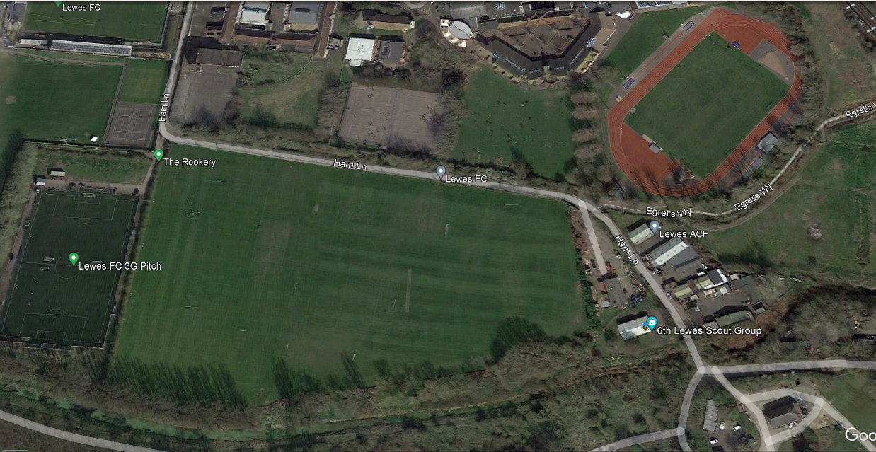
Proposed hedge

Slide 7
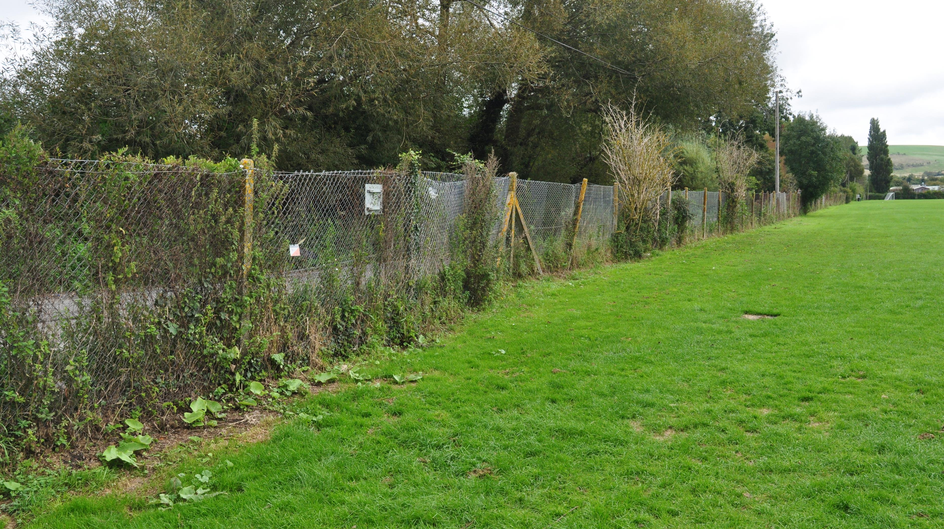
Half a metre
We have found someone who can use a rotovator to make a half metre wide planting strip

Slide 8
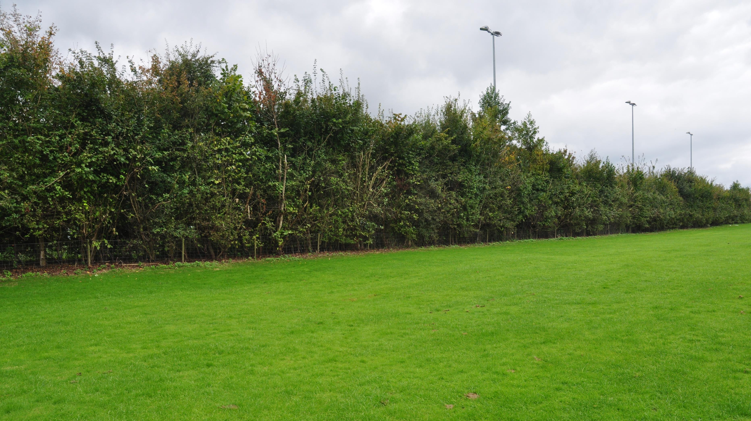
We need to avoid a high hedge like this…

Slide 9
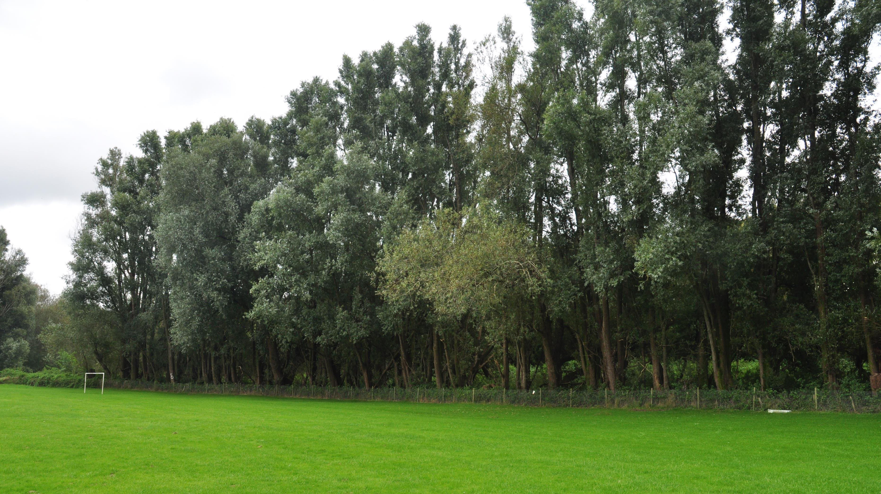
… and high trees like this

Slide 10
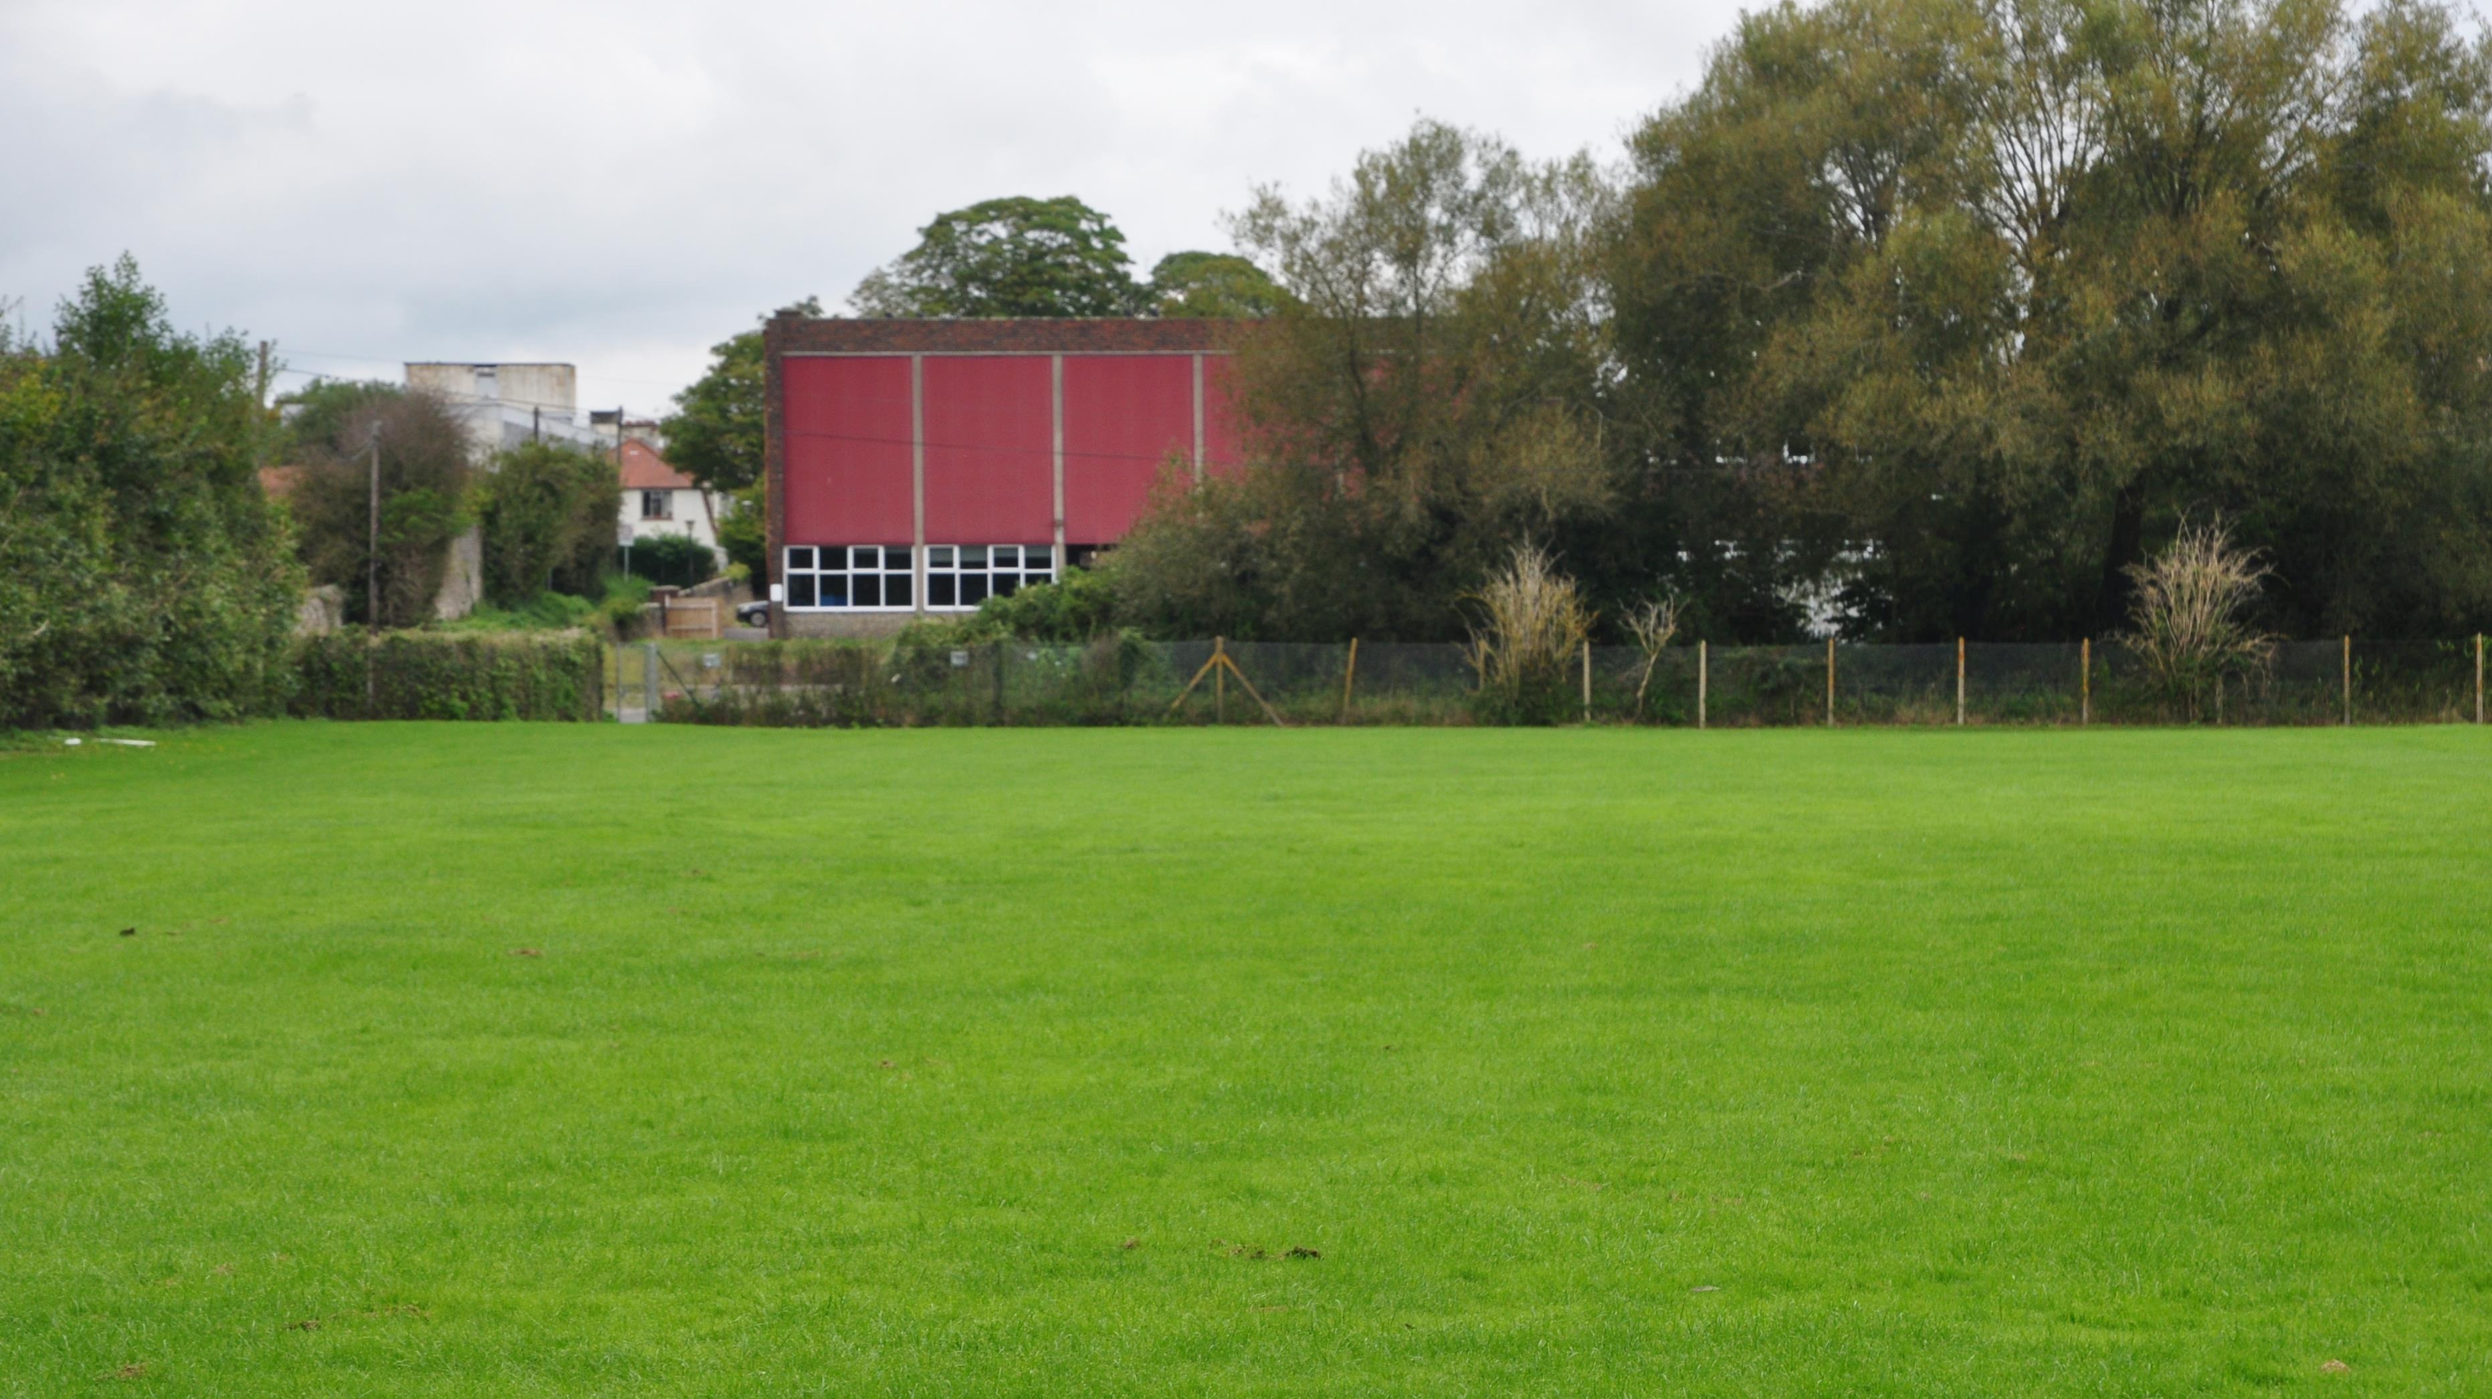
We propose a hedge height of 1.2 metres that is easy to maintain and encourages plants to grow sideways to make the hedge thicker as a corridor for wild animals and more effective in absorbing car pollution.

Slide 11
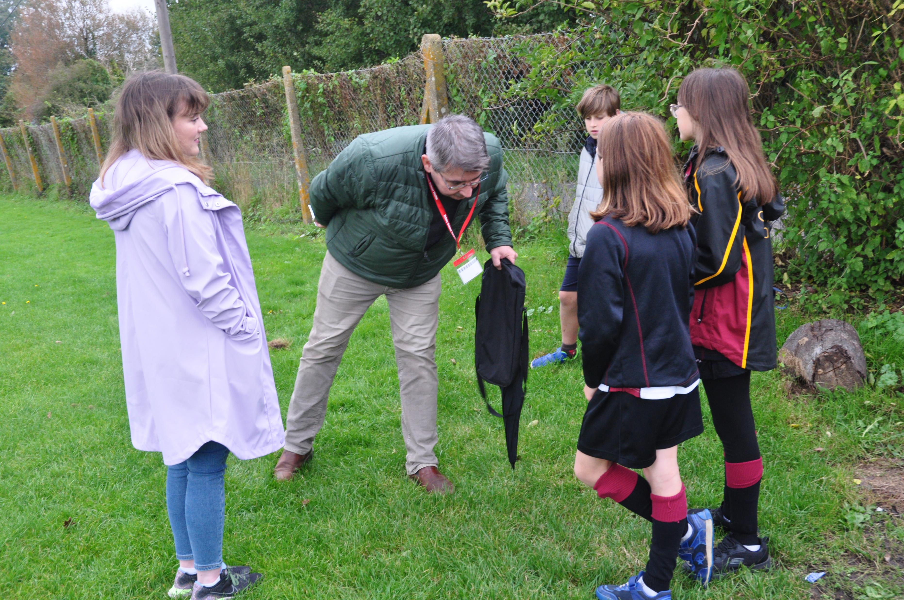
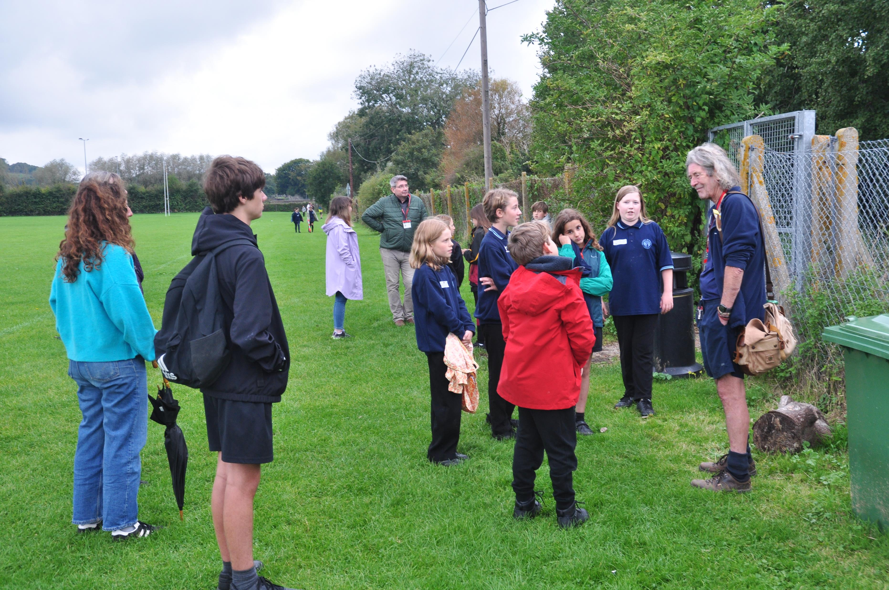
We met on-site with experts Audrey Jarvis, Nick Jarvis, Matthew Stuart, and Keith Sacre, who willingly gave their time and expertise, and we thank them for this.

Slide 12
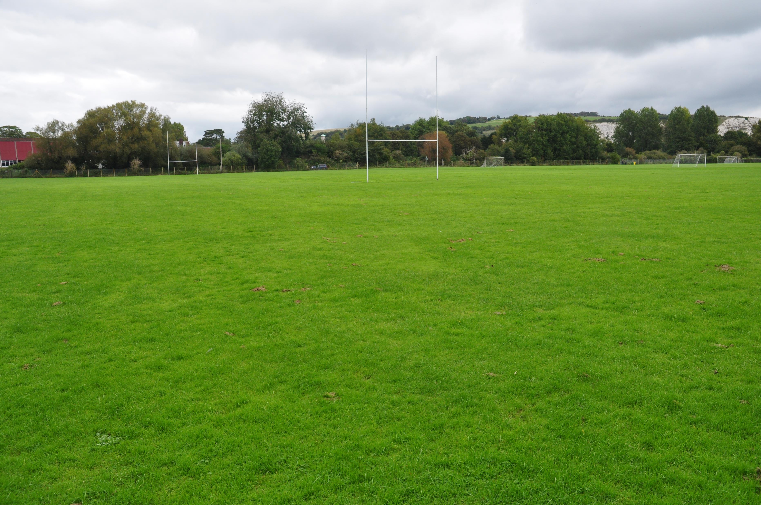
These are some of the things we learned…
Hedges provide lots of things; for example, near a road, they help reduce carbon dioxide
We were thinking it could go in double rows, so it causes the plants to bind together to make a hedge
We need to plant three plants per metre
The length is 225 metres
Therefore, we need 1350 plants (225*3)*2
We need to make sure there’s protection from animals
We need woodchip (mulch) to keep it moist, and Lewes Urban Arboretum can help.
We need plants that grow pretty slowly so we don’t have to prune it too much
Plants should include Hawthorn, Blackthorn, Hazel, and Spindle - see the list to the right
Young people and their parents (with help from experts) will plant the hedge.
It is best to plant it in winter, December to February. Due to warmer winters, we think the third weekend of January 2026 is best.
It would be good to have a sign about the project.
Field Maple
Common Dogwood
Hazel
Hawthorn
Beech
Blackthorn
Common Buckthorn
Dog Rose
Wayfaring Tree
Guelder Rose
Goat Willow
Spindle

Slide 13
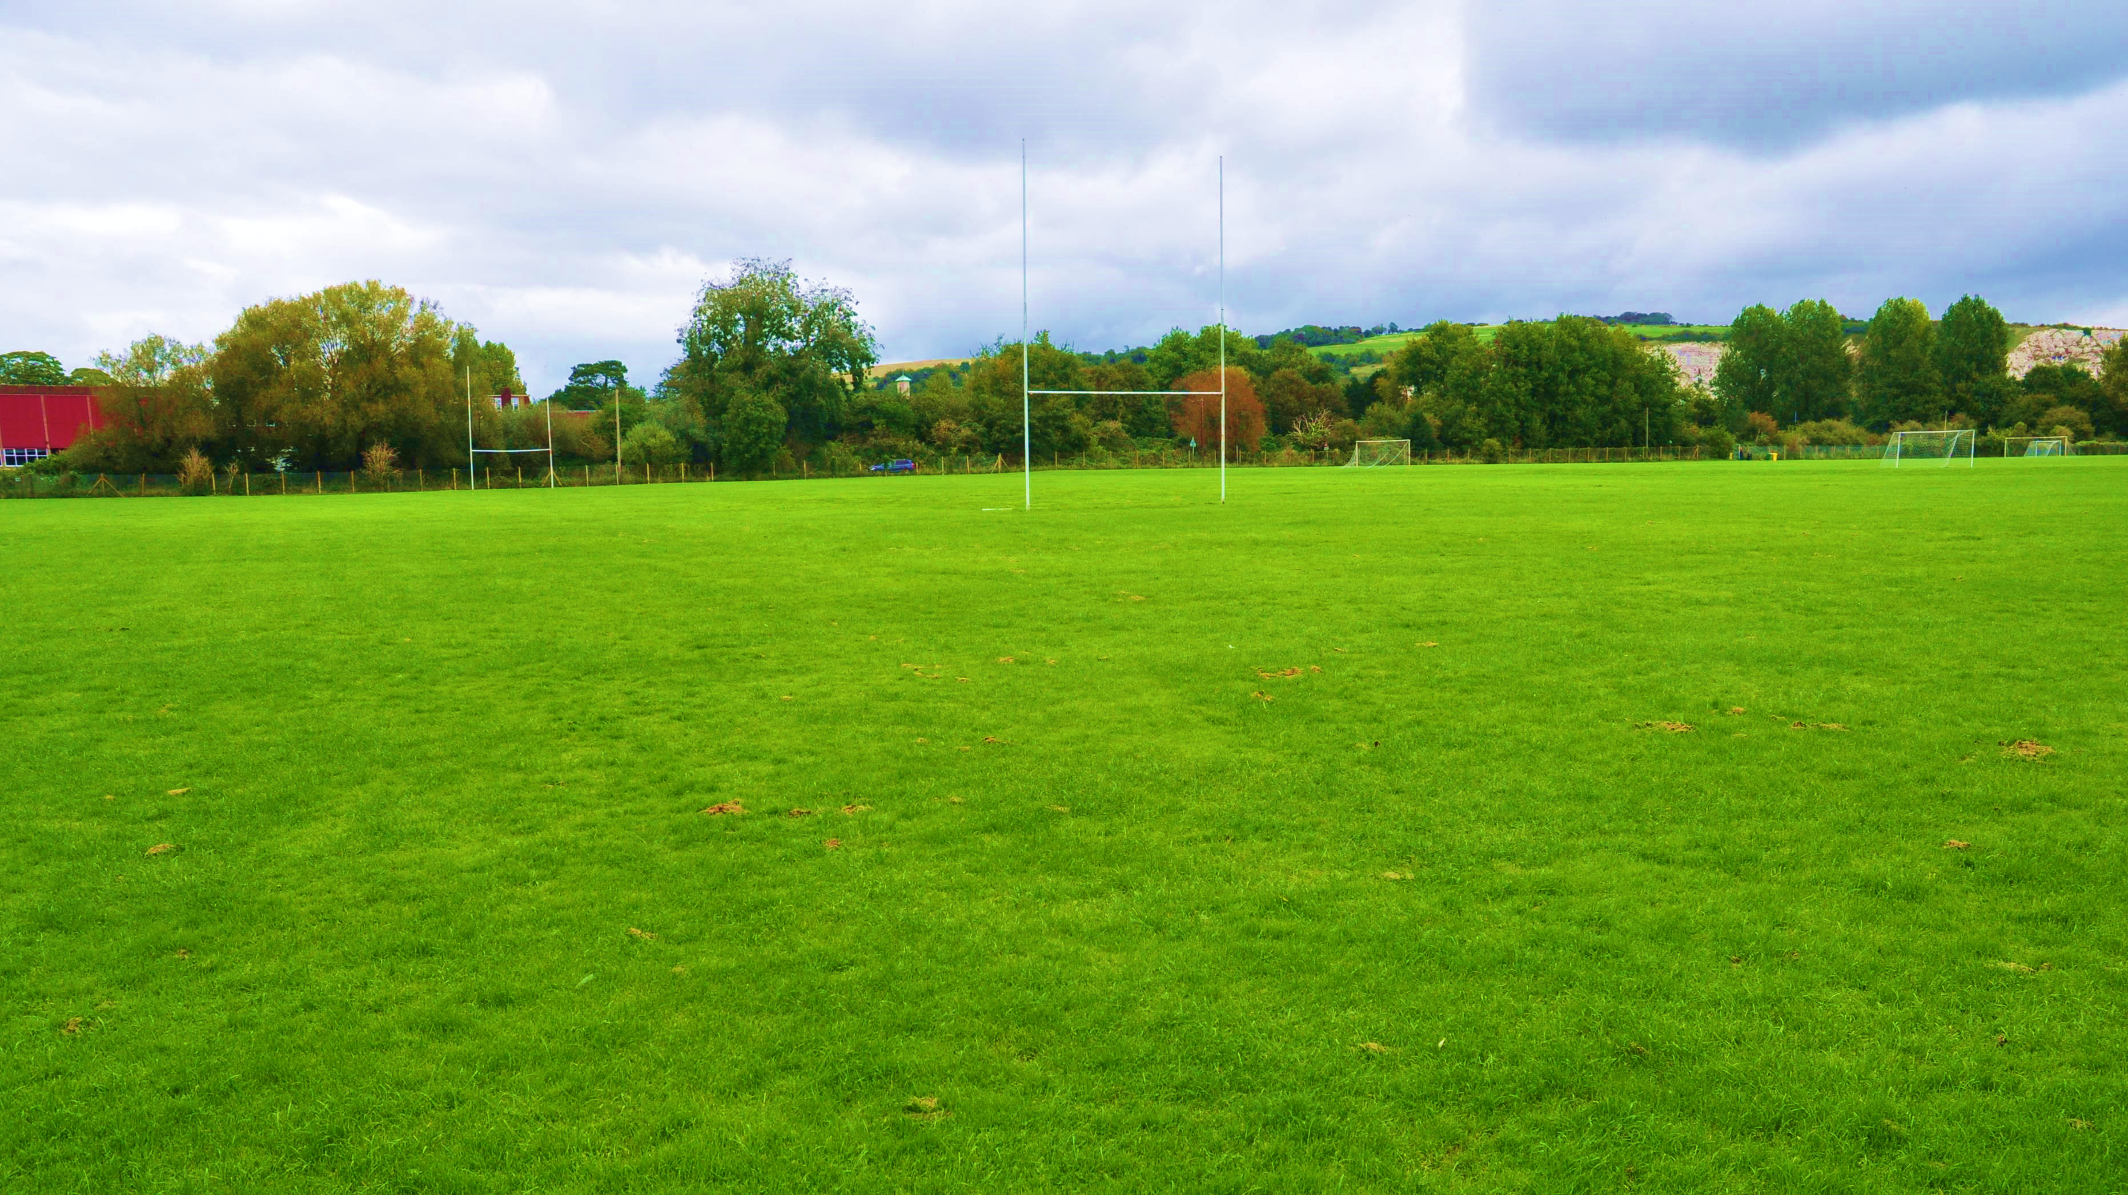
Any questions?
Questions included concerns about thorns on plants near to a sports pitch as well as points about future maintenance which were answered to everyone’s satisfaction with input from the Head of Priory and Audrey Jarvis from the Lewes Urban Arboretum. After a 7-minute discussion among the Governors, the three Board members were called back into the room and told that their project had the approval of the Governors. A success! A mass all-school planting event will take place over a weekend in January or February 2026.

